Slide 1
If PC which installed Hub have 2 network adapter for show room and office.
You can check it in command prompt type “ipconfig /all”
Show room network
Office network
Connect Hub
Hub can only register printer. But cannot get printer log data.
VW6 can print.
Hub main access to office network
example IP 192.168.0. ***
example IP 133.111.50. ***
Show room network has security which is restricted the transmission of data such as the cloud. Because the user's data is not leaked
PC can access cloud DB

Slide 2
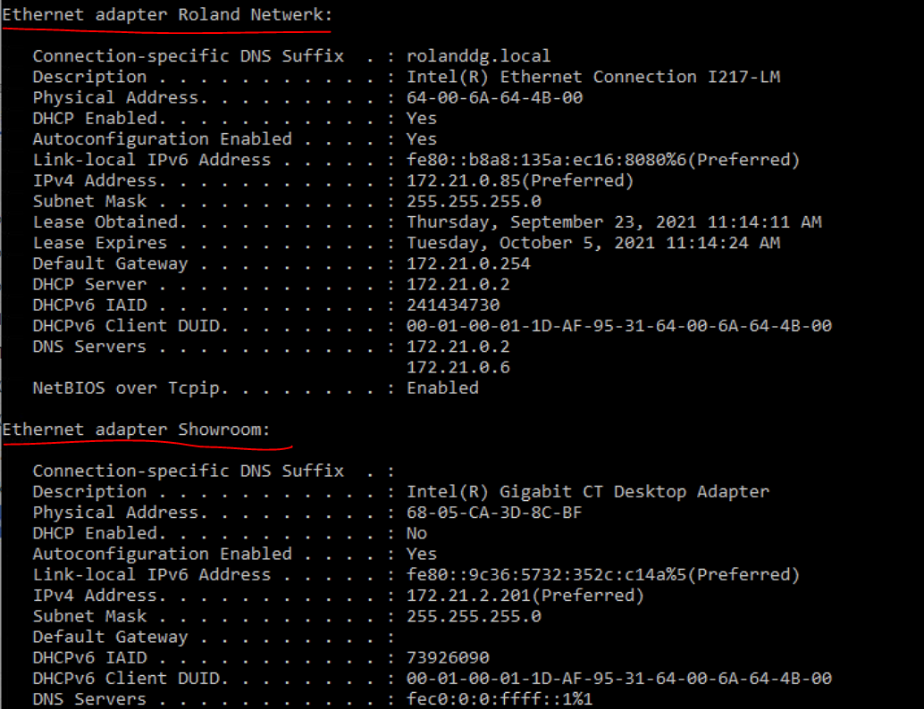
You can check how many use network adapter in command prompt type “ipconfig /all”

